Slide 1
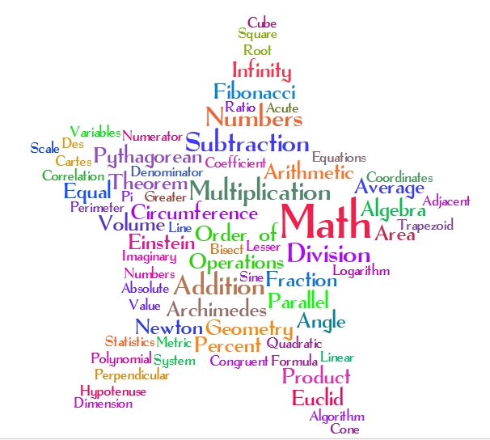
J. R. Bolger Middle School
Mathematics Presentation
December 16th, 2013

Slide 2
Why do We need to learn math?
Math is the only universal language. Anywhere you go, you can interact with people and they can understand you when you speak Math. Counting is essential everywhere.
As math teachers we teach math skills. More importantly we teach their relevance in the world outside our classroom walls. Math is not just, memorizing facts and reciting formulas. It’s…
“Everything can be though of as a math problem.”
The Math Curse by Jon Scieszka
Notes:
*Trig. Trains our brains to problem solve while reinforcing basic math.
*Toddlers count innocent math

Slide 3
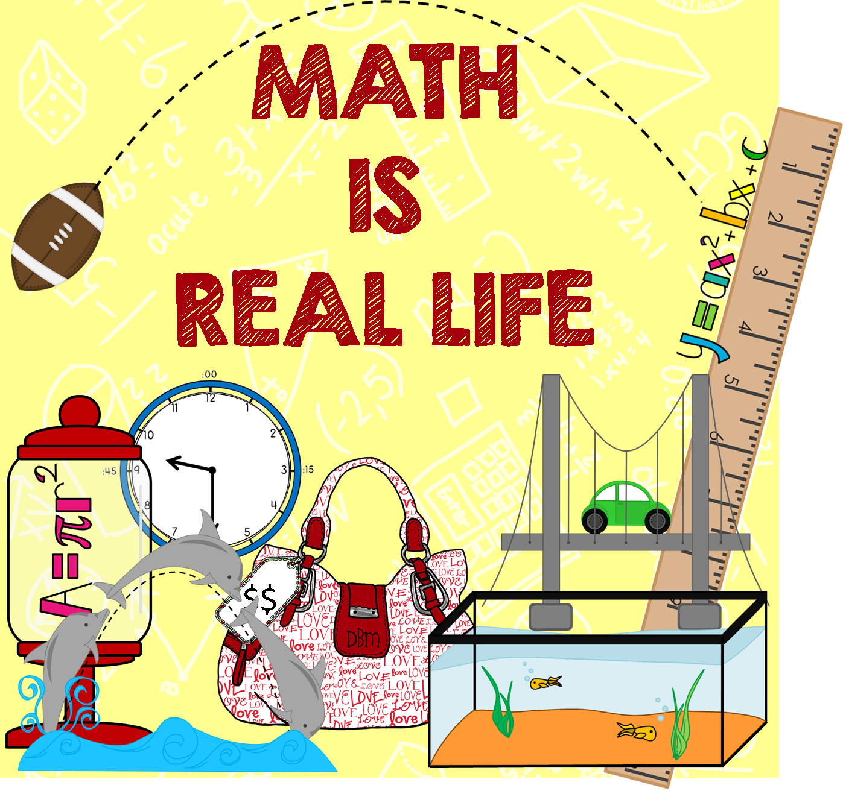
Calculating time
Ordering lunch
Counting change
Planning a budget
Cooking/baking
Purchasing items
Playing an instrument/reading music
Grades/scores
Mortgages/rent
Athletes: times, scores, averages, quarters/innings
Video games
Calendars
Telling time
Board games(logic)
Math is everywhere!
Many jobs and hobbies require a
quick, logical decision making mind.
Math provided the basis to creatively solve problems.

Slide 4
Core Content State Standards Mathematics
The curriculums for 5th through 8th grades have been aligned to the CCS. Our curriculums are working documents. Each is designed to ensure that our students will have the the skills & concepts needed for the NJASK/PARCC assessment. While also preparing our students for the next grade level and success in the real world.
l
Each grade level concentrates on developing students’ problem solving skills through the use of real world problems. Students are encouraged to:
Explain responses
Use logical reasoning
Relate operations
Debate/discuss solution steps & ideas
Notes:
Apply & extend previous understanding

Slide 5
Common Core Standards
Skills & Concepts
Each grade level has 5 main strands.
Fifth Grade:
Fractions
Number Sense
Geometry
Operations & Algebraic Thinking
Measurement
Sixth Grade:
Ratios & Proportional Relationships
Number System
Geometry
Statistics & Probability
Expressions & Equations

Slide 6
Common Core Standards
Skills & Concepts
Seventh Grade:
Ratios & Proportional Relationships
Number System
Geometry
Statistics & Probability
Expressions & Equations
Eighth Grade:
Number System
Geometry
Statistics & Probability
Expressions & Equations
Functions
Notes:
Fluently add, sub, mult. & divide
Sixth & seventh strands are the same
Every grade level has number systems &
Geometry

Slide 7
Differentiated Instruction & Data
Data is continuously collected & used to better understand our students, guide our lessons, and ensure that we are meeting the needs of each child.
Data may include:
Slate assessments
Benchmarks
Unit assessments
Quizzes
Interactive learning game scores
Group work
Projects
Exit questions
Small group work
One on one interactions
Leveled homework

Slide 8
Technology in the Mathematics Class
Technology is used frequently to enhance lessons, differentiate instruction,
provide enrichment and/or reteaching. Technology allows teachers to foster
an interactive, individualized learning plan.
Types of technology:
Videos
Projection units/Elmos
Macbooks/I Pads
Online text books
Teacher Web Pages/ Porta Portals
Interactive Learning Games
Notes:
Study jam Videos
Interactive leveled games
IXL passwords

Slide 9
What can you do to help your child?
Talk to your child…what did you work on in math class today?
Check to see if your child has homework and/or a review
Go to the Bolger homepage and on click onto a teacher’s web page
Turn everyday tasks into math problems *
Highlight when you are using math
Check your child’s grades on Genesis
Visit interactive websites (parents/guardians & students)
Contact your child’s teacher
Notes:
*Example: there are 6 people at the table each person
Math a tube
Teacher tube

Slide 10
Questions

